Slide 1
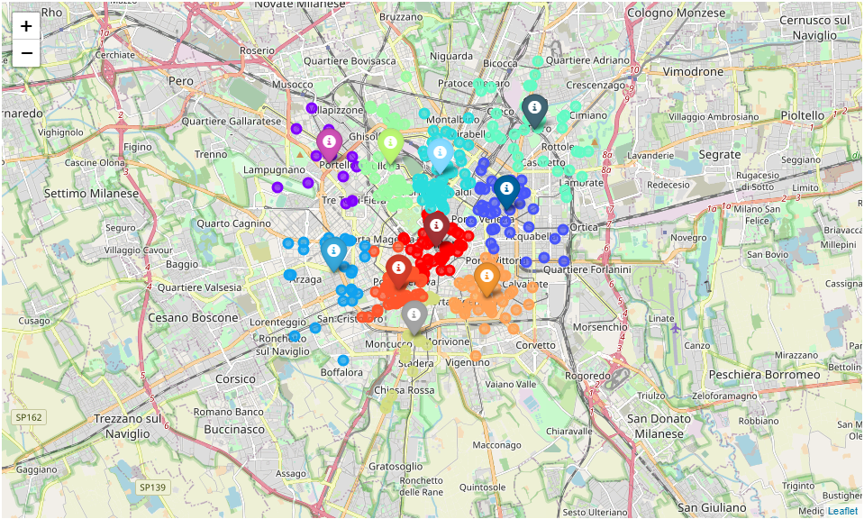
Food Delivery Optimization in Milan
Coursera capstone project
by daniele fistolera

Slide 2
Introduction
The goal of the project is to find the best placements for 10 food couriers bases in Milan;
The target audience are the food delivery companies in Milan because the optimal organization between couriers and restaraunts is essential to create an efficient and profitable system.

Slide 3
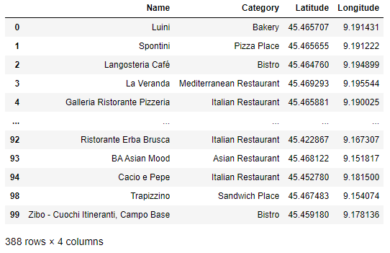
Data Description
The data is gathered trough the Foursquare API;
The information obtained are name of the venue, category of cuisine and location coordinates.

Slide 4
Methodology
Through a K-means alghoritm with 10 center point we will define the locations which minimize the distance between the couriers bases and the venues, but keeping the bases at maximum distance;
After the clusterization each group is analysed counting the number of venues, the mean distance between bases and restaurants and the cuisine categories.

Slide 5
Results: Cluster Map
The kmeans process produce the following result:

Slide 6
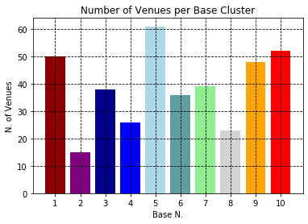
Results: Number of Venues
The number of venues per cluster are:

Slide 7
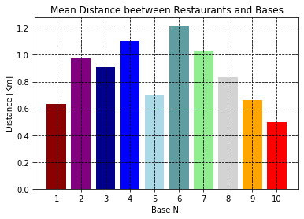
Results: Mean Distance
The mean distance between bases and venues are:

Slide 8
Discussion
It is possible to locate the position of the basis;
The number of venues is an indicator of how many orders the base will recieve;
Cluster with more venues have in general less mean distance;
Cluster categories could be used to optimize the service.

Slide 9
Conclusion
The principal objective of finding the location of 10 courier basis is satisfied;
Additional information from cluster analysis permit to optimize the service.

